Slide 1
CCCU Building 2 Website Project
David Filipiak, Nathan Shuttleworth, Harry Davidson, Jordan Carpenter, Michael Adelodun, Christopher Kerr

Slide 2
Software Development Life Cycle
AGILE
Flexible and easy to follow
Predictable delivery of the product
Allows for change
Six iterations in total, each two weeks long
First two iterations – planning stage
Other four iterations – development stage
One week at the end for final touches
Customer feedback
Team meetings:
Official meetings once every week, where we catch up on everyone's progress
Communication during the other days in case of any issues
Meetings via Discord

Slide 3
Time plan
Iteration | Dates | Work to be done
1 | 8.2.2021 | Read project description, set out communication and meetings, list initial ideas for the project, split the tasks between team members
 | 15.2.2021 | Further develop ideas, come up with questions for the customers and gather the project requirements
2 | 22.2.2021 | Informational architecture, Wireframes, functional and non-functional requirements
 | 1.3.2021 | Presentation making and submission
3 | 8.3.2021 | Main page: HTML and CSS
 | 15.3.2021 | Main page: JavaScript and other functionality
4 | 22.3.2021 | Gallery page: HTML and CSS
 | 29.3.2021 | Gallery page: JavaScript and other functionality
5 | 5.4.2021 | Contact page: HTML and CSS
 | 12.4.2021 | Contact page: JavaScript and other functionality
6 | 19.4.2021 | Map page: HTML and CSS
 | 26.4.2021 | Map page: JavaScript and other functionality
--- | 3.5.2021 | Final touches and minor bug fixes.

Slide 4
Features that we would like to implement
A virtual walk through of some part of the building
Virtual galleries
Interactive Map showing details of parts of the building and the facilities located there.
Images of buildings construction
Area displaying contact details for the building

Slide 5
Justification of features for clients and shareholders
Primarily to display relevant information to the main users of the building, which will mostly be students and university staff.
Will contain interactive features to give people a good idea of what to expect, as well as aid with navigating
‘Showing off’ the building and its facilities is important as it can help persuade prospective students to study here.

Slide 6
Requirements
Functional Requirements
Non-functional Requirements
Website search bar should work as intended.
To ensure functionality of the virtual walk through is good.
User should be able to access virtual galleries as intended.
To ensure Interactive map works throughout sections of the building.
To produce a user-friendly GUI.
The styles and themes of the website will be an extension of those used on other university websites.
This will include a colour scheme primarily featuring red, white and blue, and the font Recoleta.
To produce a website that is secure to visit.
To ensure the website is runs successfully without any errors.

Slide 7
Style and formatting information
Follow the style and colour theme of other university websites
Mainly red, white and blue colours
Recoleta font for headings
Humanist font for paragraphs
University logo in the top left corner

Slide 8
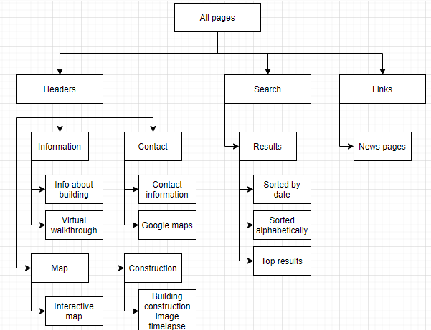
Informational Architecture
Proposed sitemap for website, showing which pages will have which content and how they link together

Slide 9
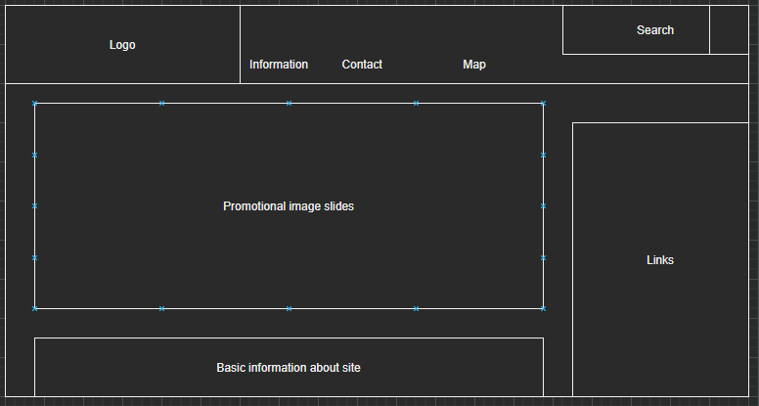
Examples of content – Landing Page
This page will include all of the basic information about the building and some pictures of it. Its main purpose is as the first page the user accesses, to then link to the other pages which have a more focused purpose.

Slide 10
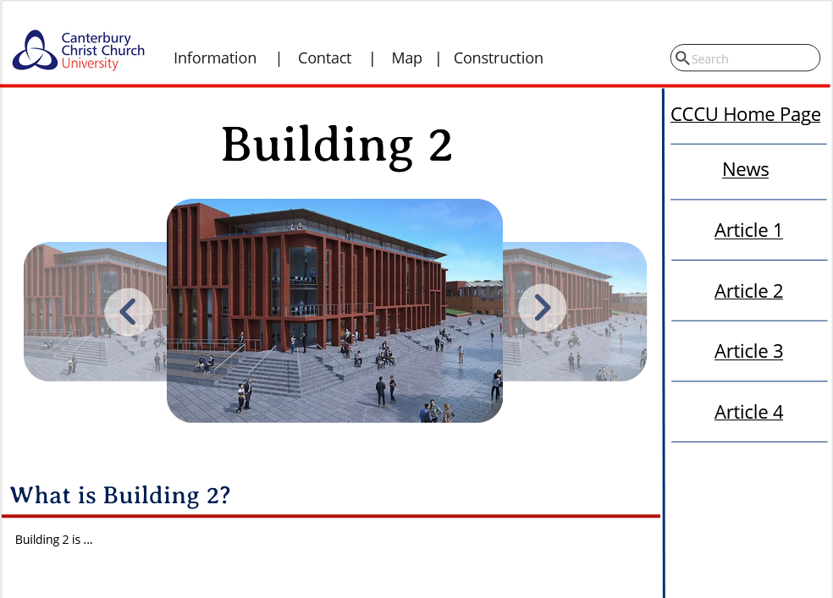
Main page mock-up

Slide 11
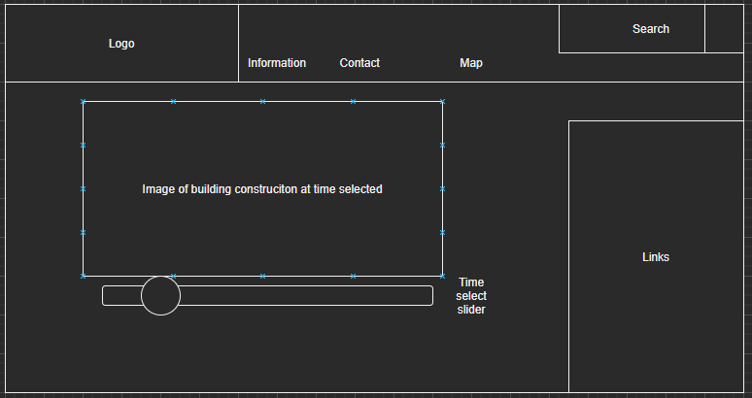
Examples of content – Image gallery and timelapse
Image gallery and controllable image time lapse of building construction

Slide 12
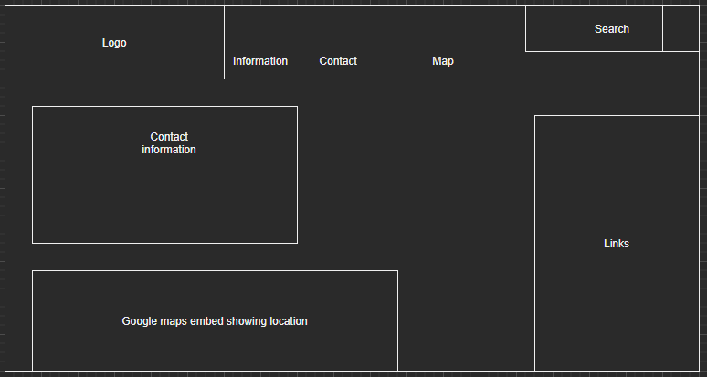
Examples of content – Contact page
Page with e-mail and phone number details etc. Also google maps embed detailing location of the building

Slide 13
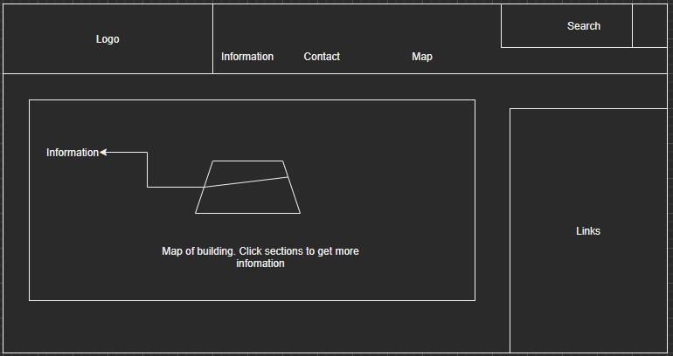
Examples of content – Interactive map
Interactive map of the building. When you click on part of it, that part is highlighted and more information is shown such as what subjects are studied on that floor and what facilities are available

Slide 14
Role allocation
Roles were allocated based on previous web coding experience and what participants were interested in working on
This will likely change when the project begins but is a good estimation.
When someone is done with their task, they help other team members who are having issues
Person | Role | Justification
David | JavaScript coding | Quite good at OOP and would like to work on these aspects of the project.
Nathan | CSS and style sheet coding | Interested in determining the look and feel of the website
Harry | Page linking and search bar | Has prior experience with working on search functions in websites.
Michael | HTML | Is interested in improving his prior HTML skills
Jordan | HTML | Has used HTML previously and has some experience in this area.
Chris | Work on interactive building map | Came up with this idea, so would be best suited to overseeing it.

Slide 15
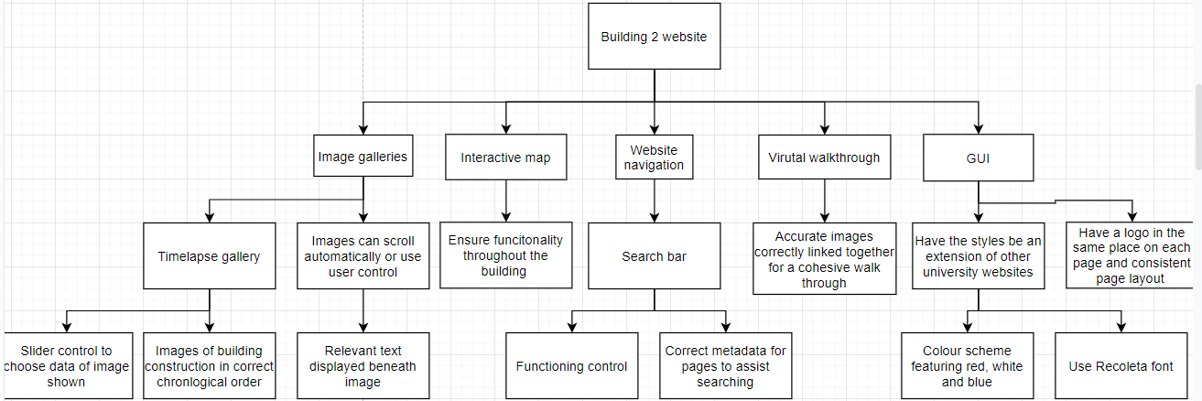
Work Breakdown Structure

Slide 16






Languages and tools
Browser Developer Tools

Slide 17
Testing
JavaScript unit tests (JEST, MochaJS, ...)
A majority of the testing will be functionality testing, to ensure that the content and the website itself works properly.
Regression testing at the end of each iteration – check if the new features pass previous unit tests

